Slide 1
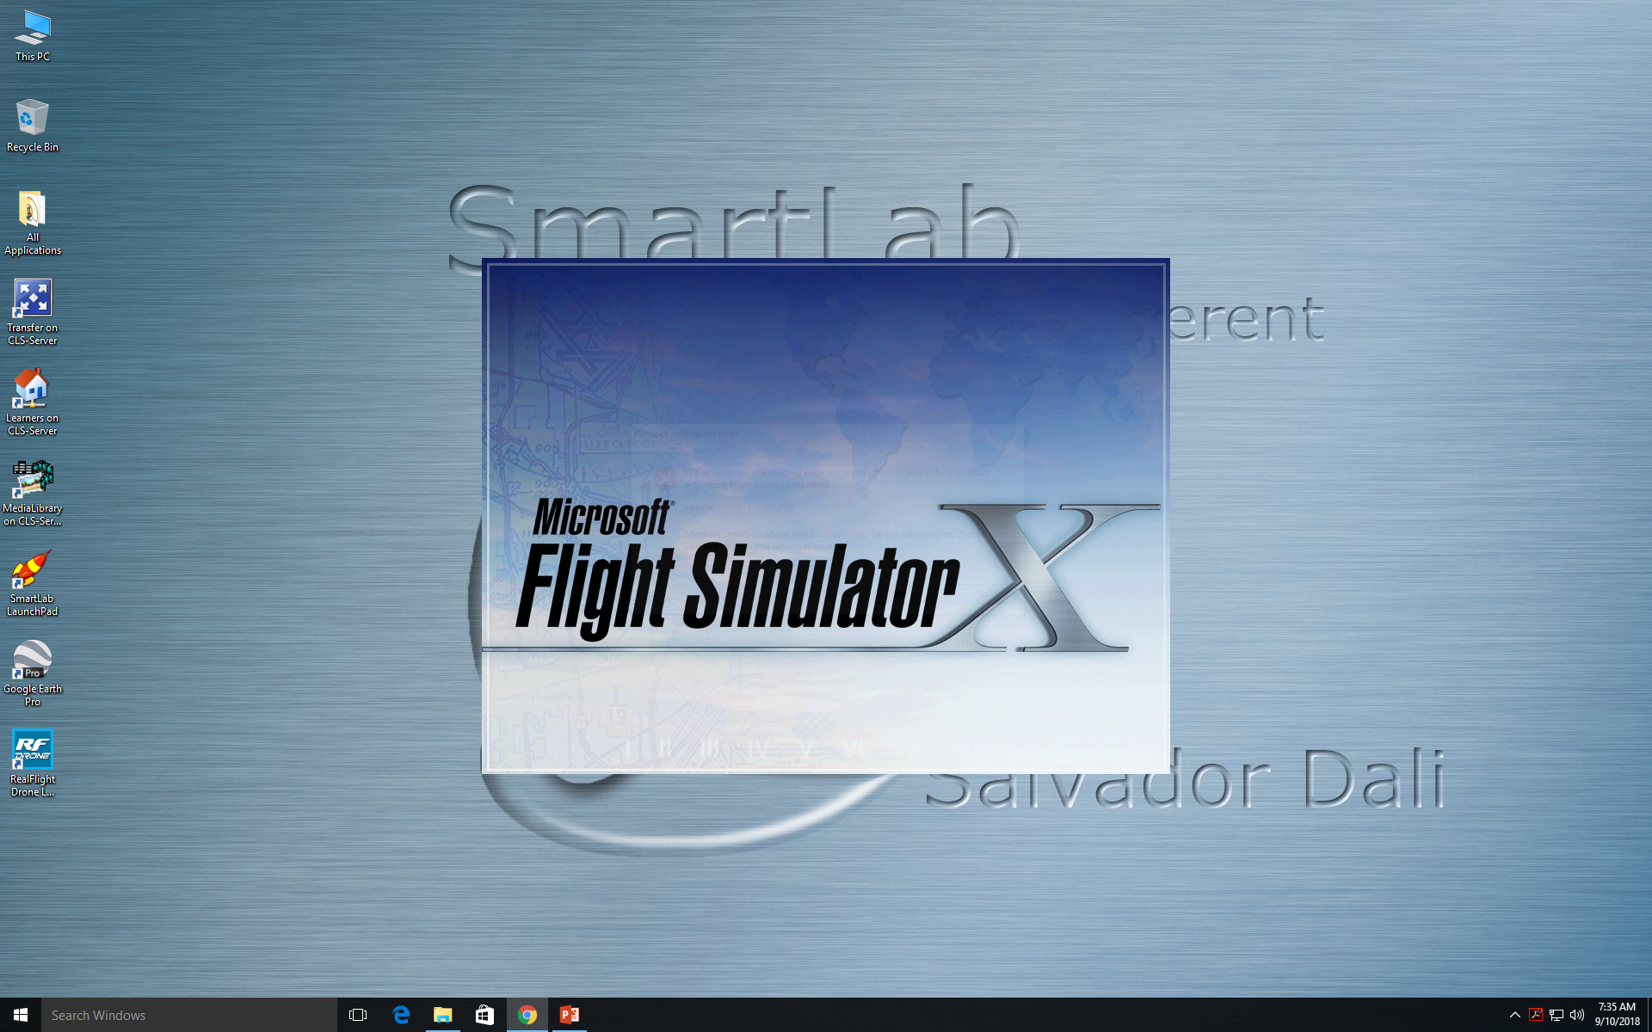
Flight Sim realism/crashes
By Ashton Ray and Carter Edwards

Slide 2
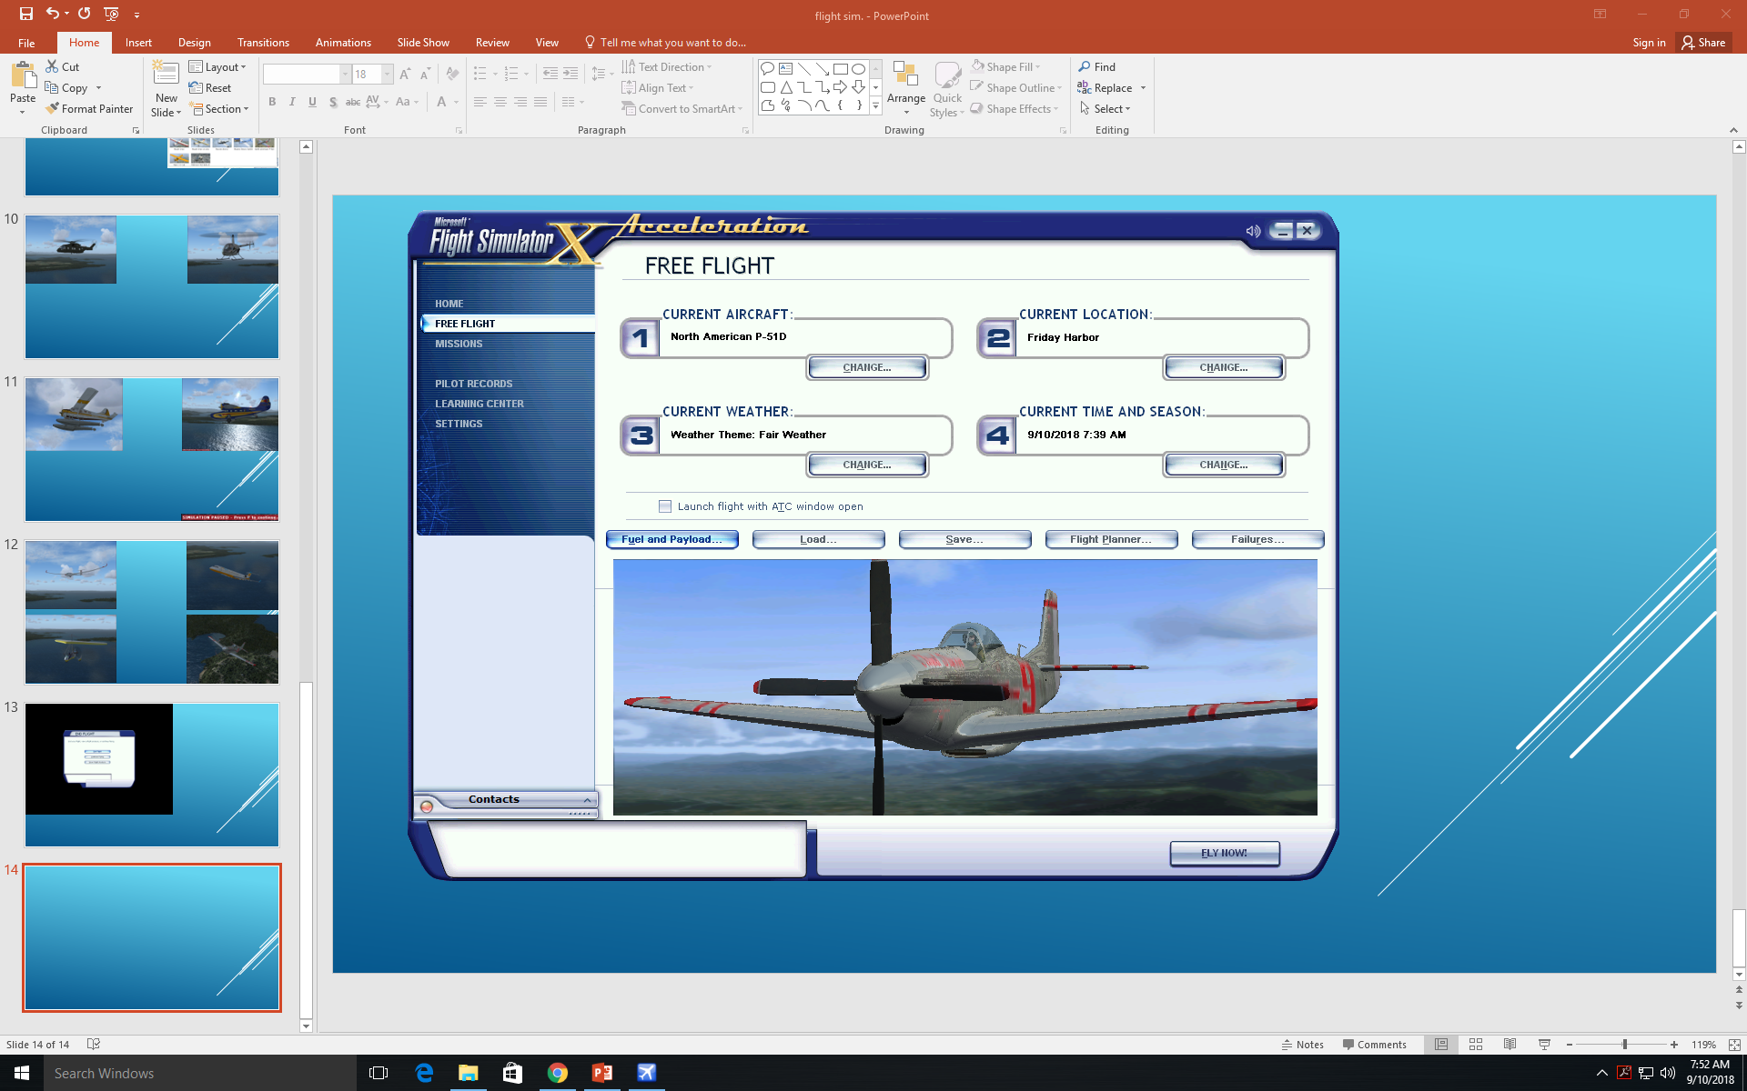
In the free flight menu you can change multiple things like weather, failures, aircraft, time, and location.

Slide 3
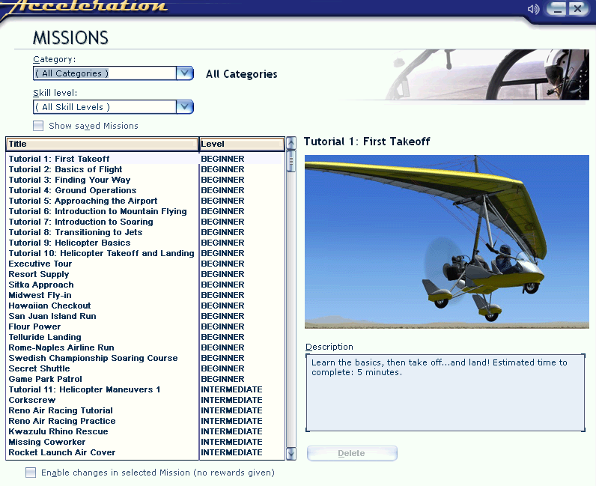
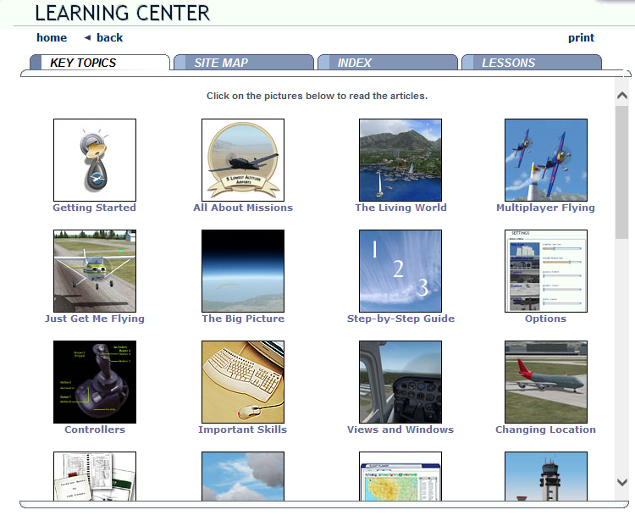
Go to learning center if you need help if the PowerPoint does not help you.
You can go to missions to look at missions.

Slide 4
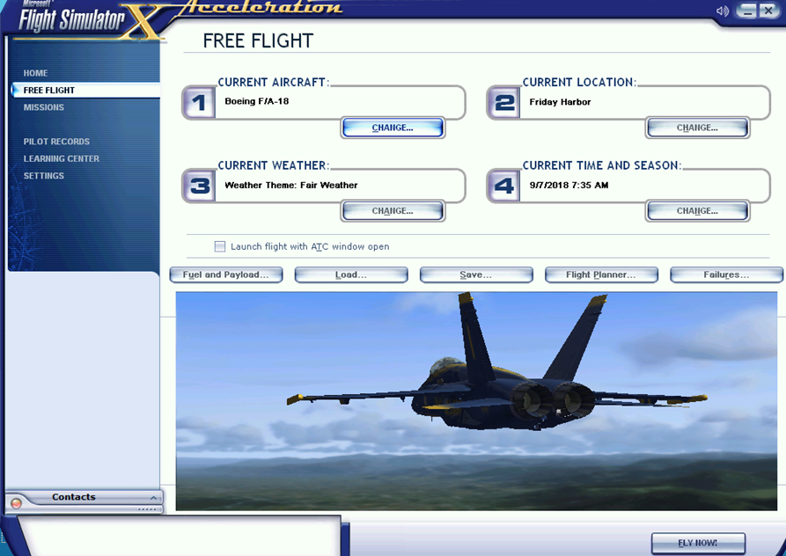
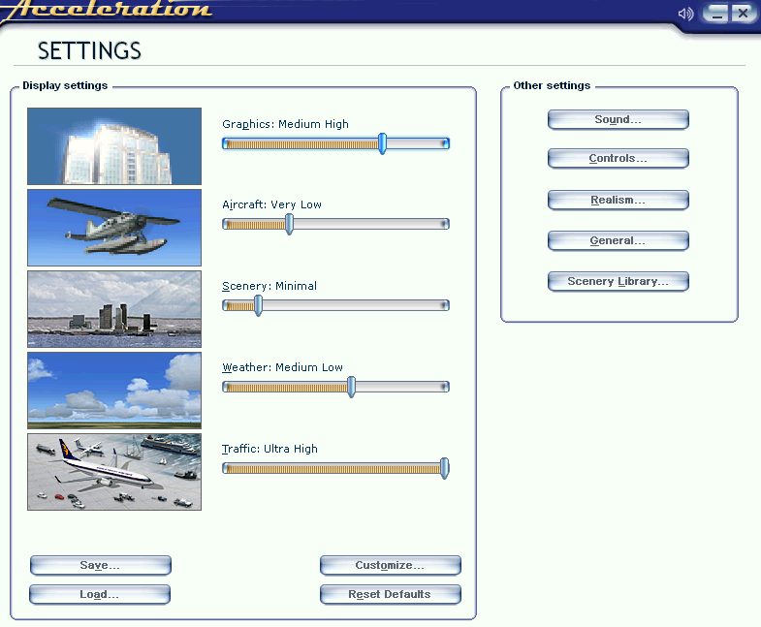
So now how to turn on crashes.
We are going to go to settings.
You can change how you want your display settings. You can leave them how you want.

Slide 5
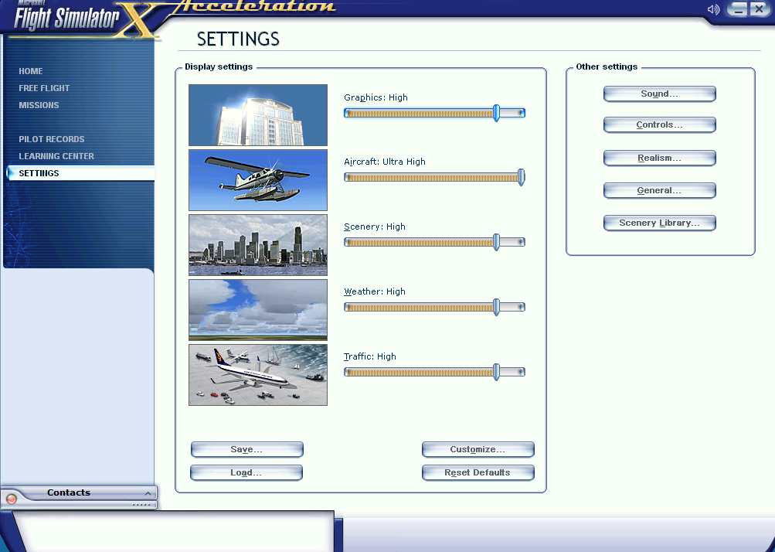

Go to Realism

Slide 6
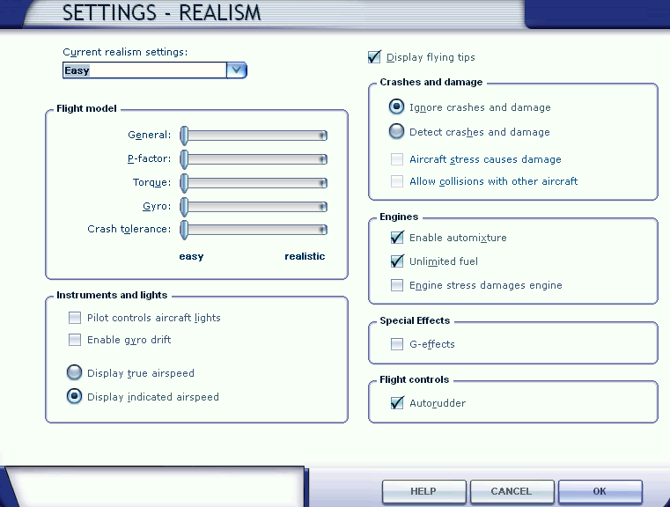
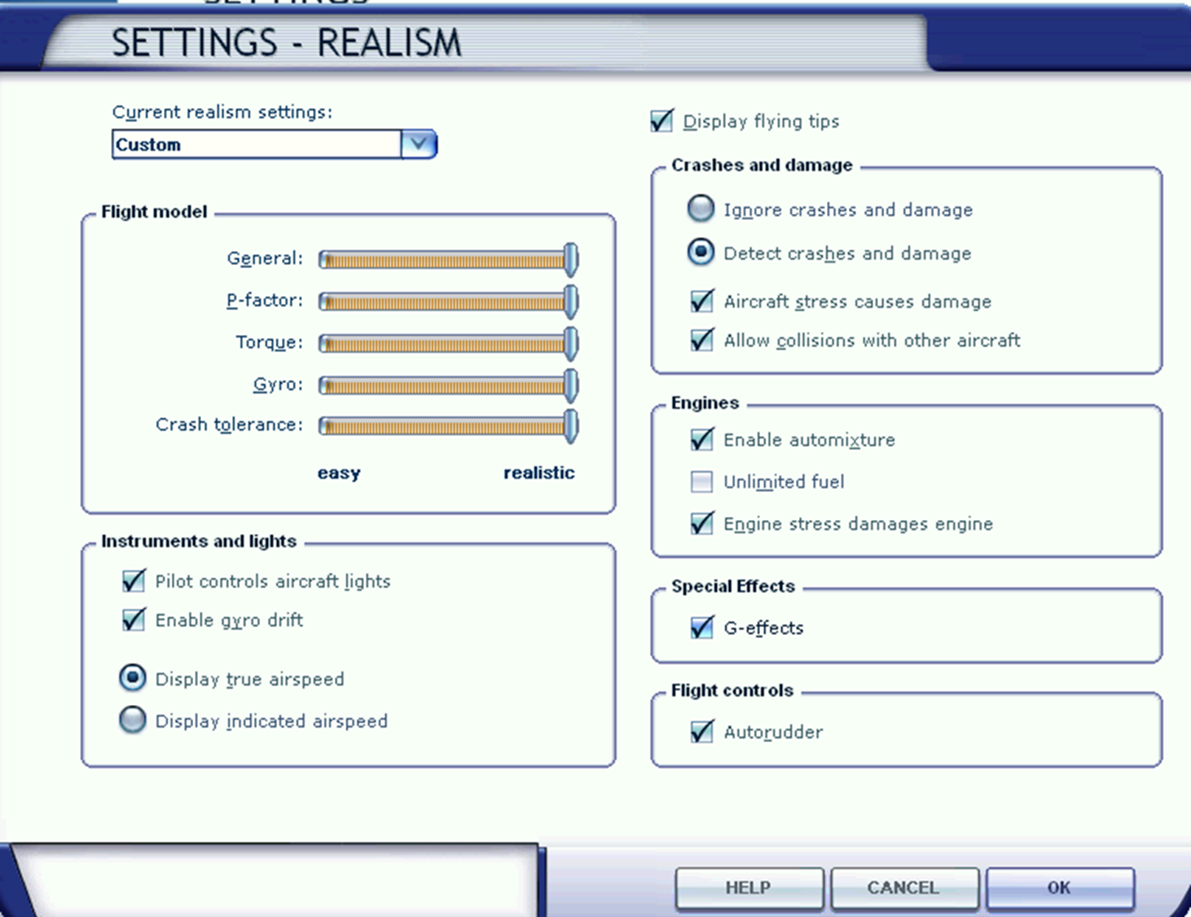
We want to change/switch everything, do what I turned on/off.
This is what is going to look like.
I forgot to turn off the auto rudder you want to turn that off.

Slide 7
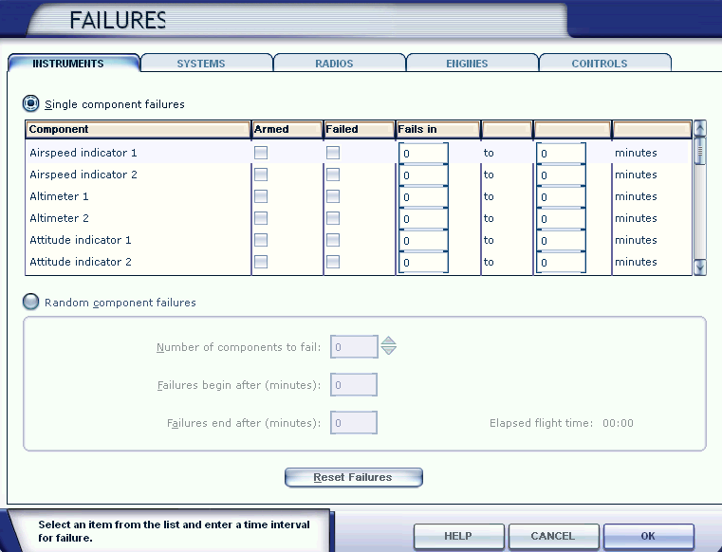
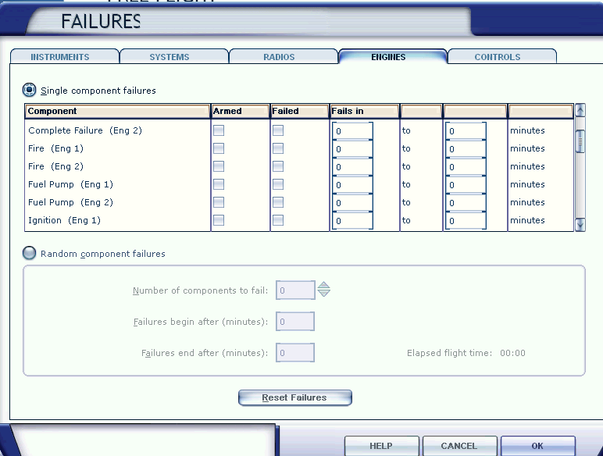
You can turn on and off different fails.
There are tons of fails.

Slide 8
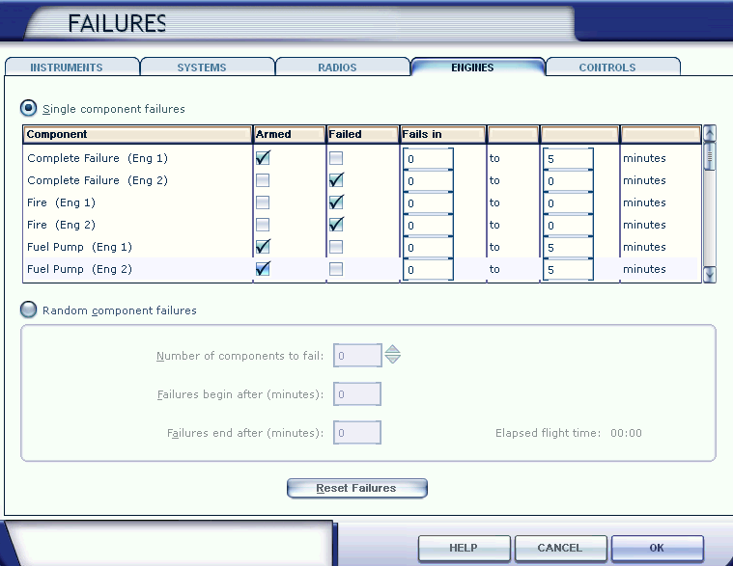
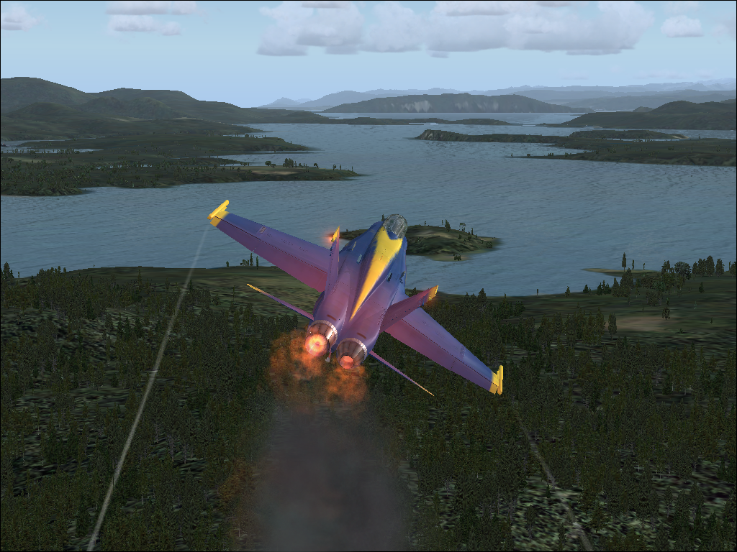
We will turn on some of them. You don’t have to turn on the ones I did.
Here is what it will look like. It may look different depending on what you turned on.

Slide 9
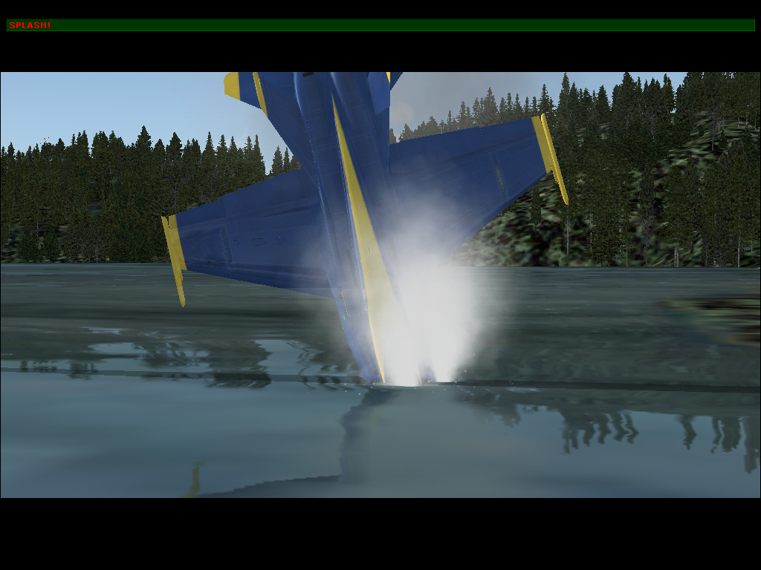
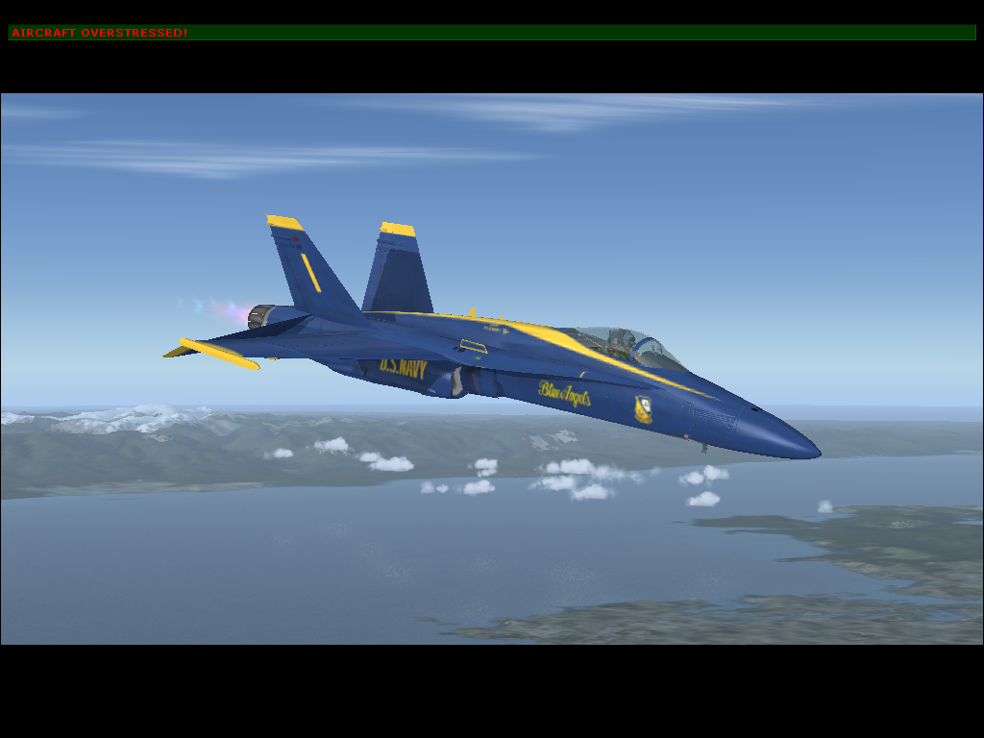
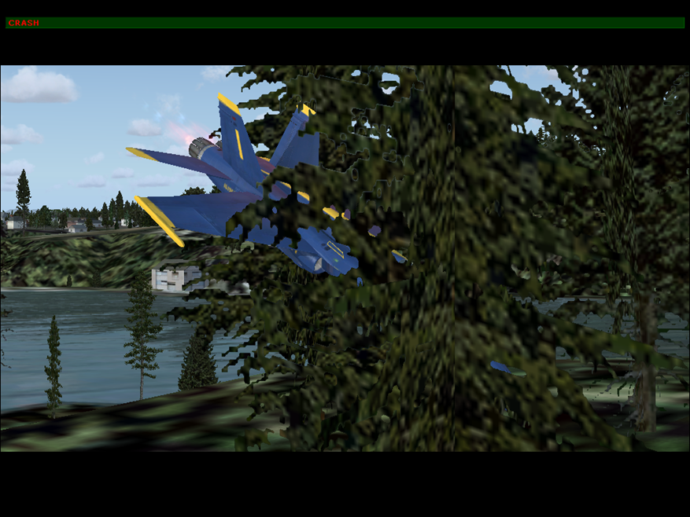
With the crashes on there are different types of crashes.

Slide 10
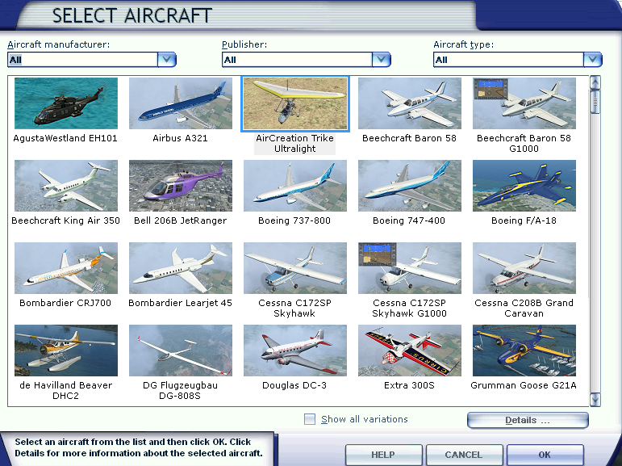
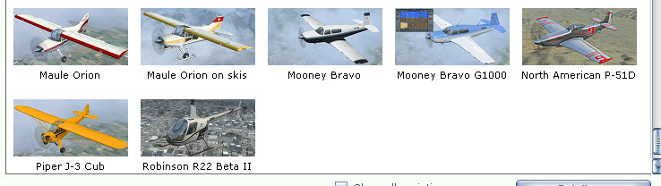
There are tons of different types of aircraft.

Slide 11
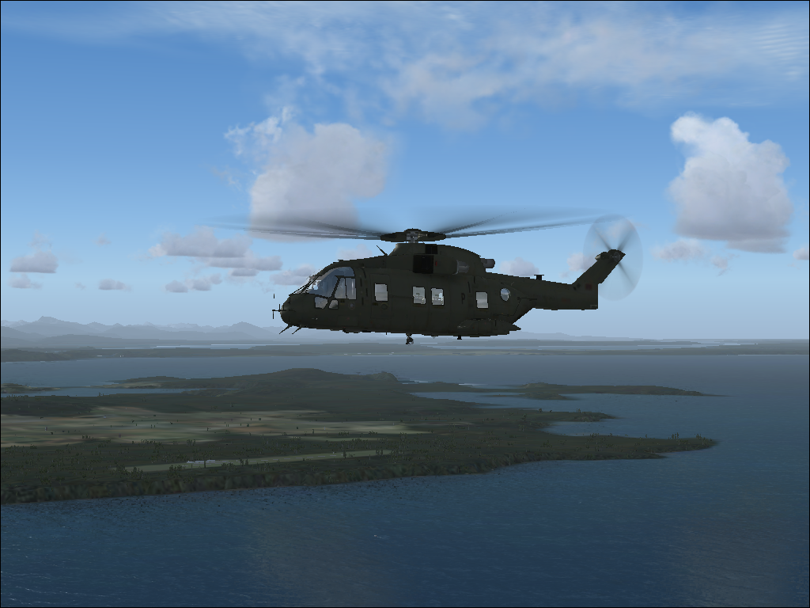
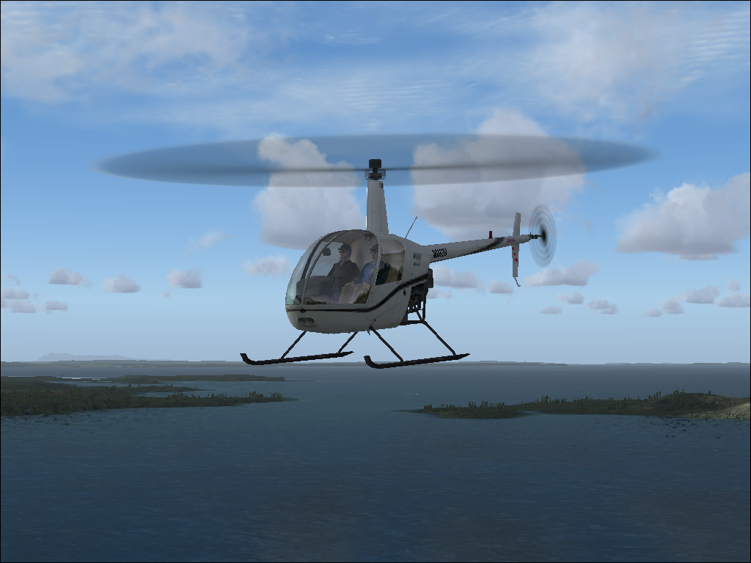
There are helicopters.

Slide 12
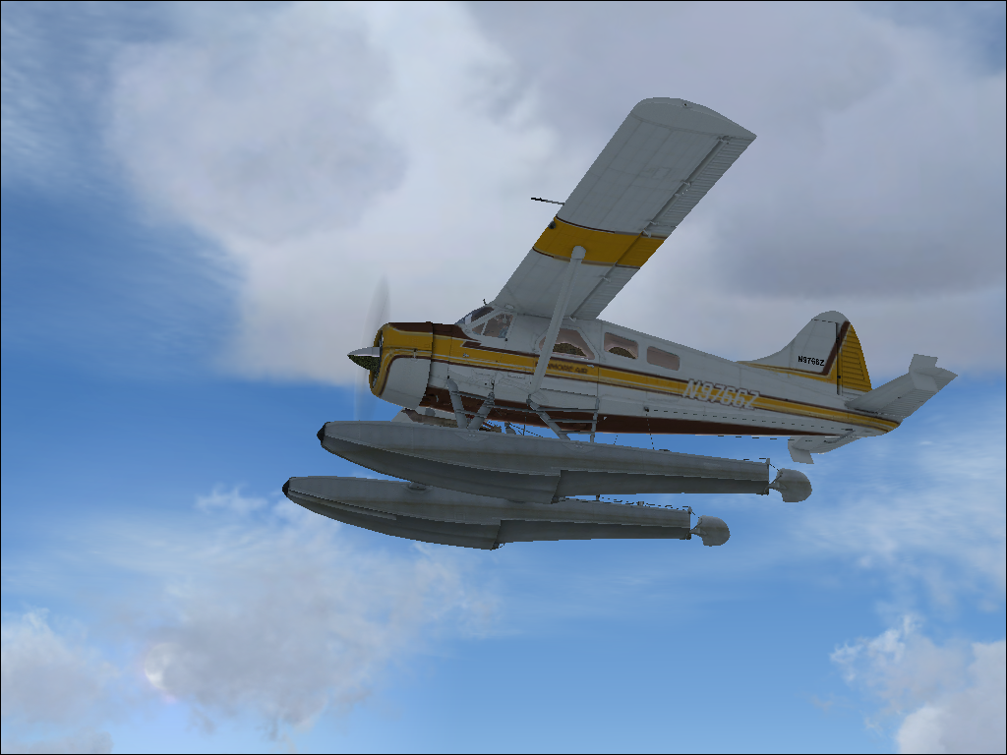
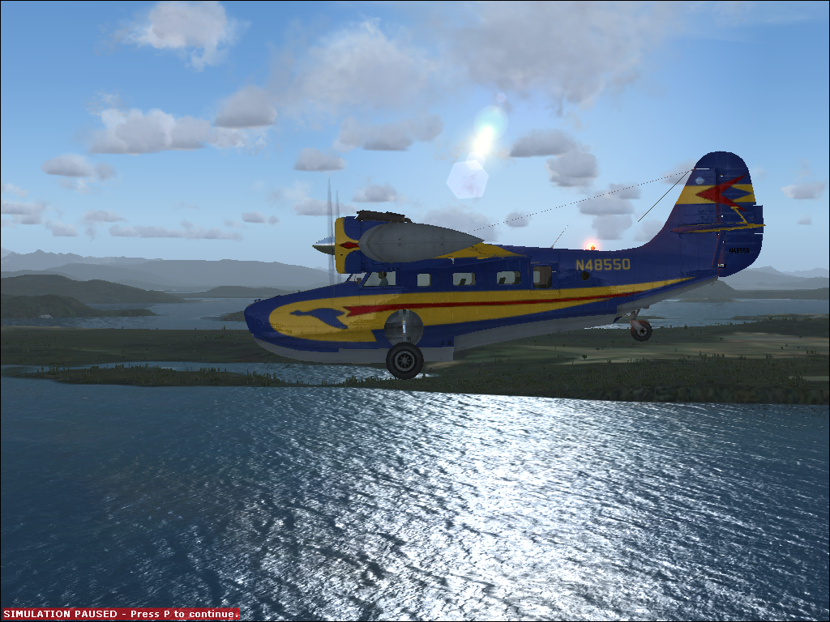
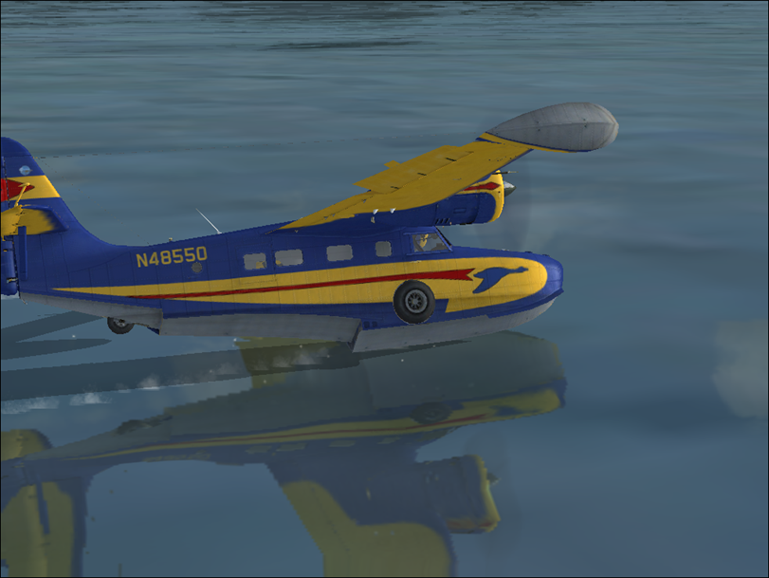
These airplanes can land in water where others can’t.
You can also pause it and un-pause with p.

Slide 13
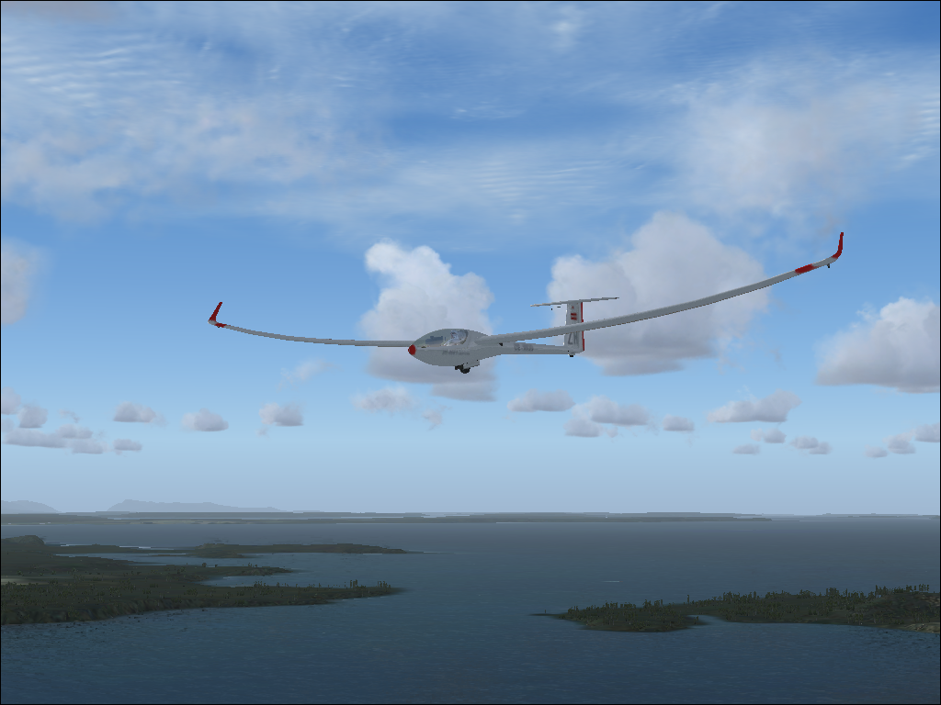
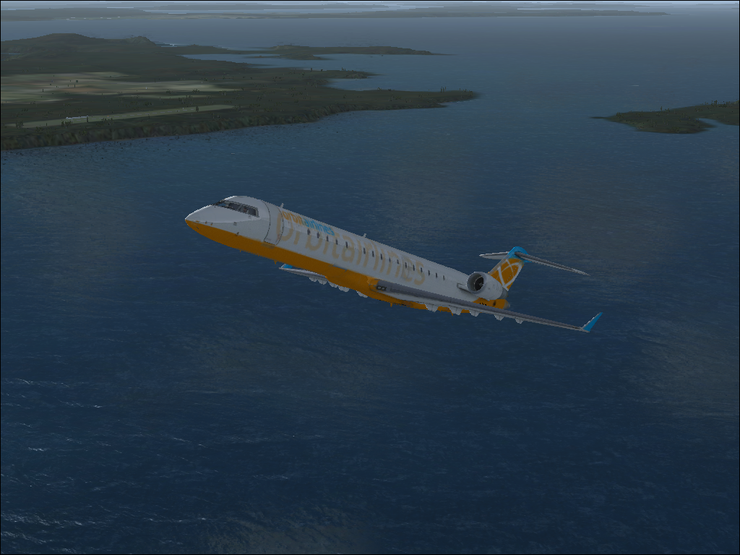
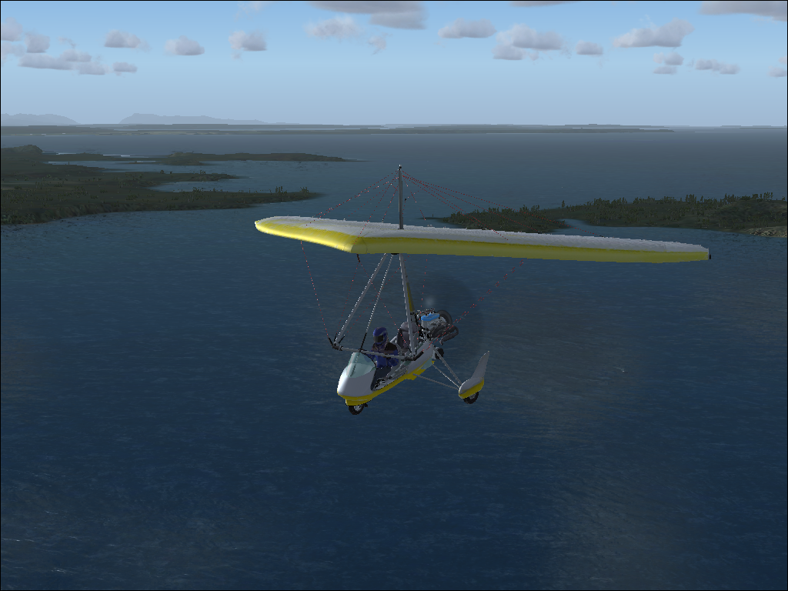
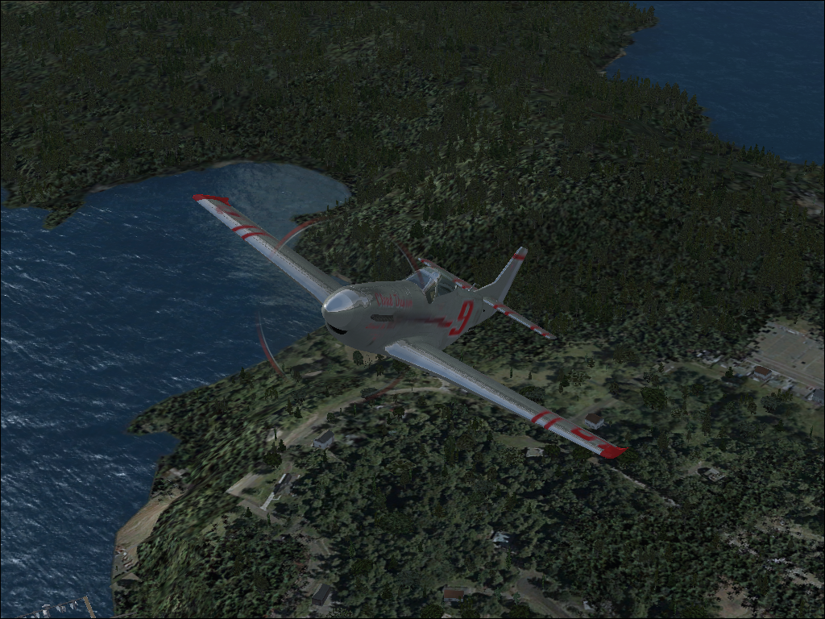
Here are just some other types of planes

Slide 14
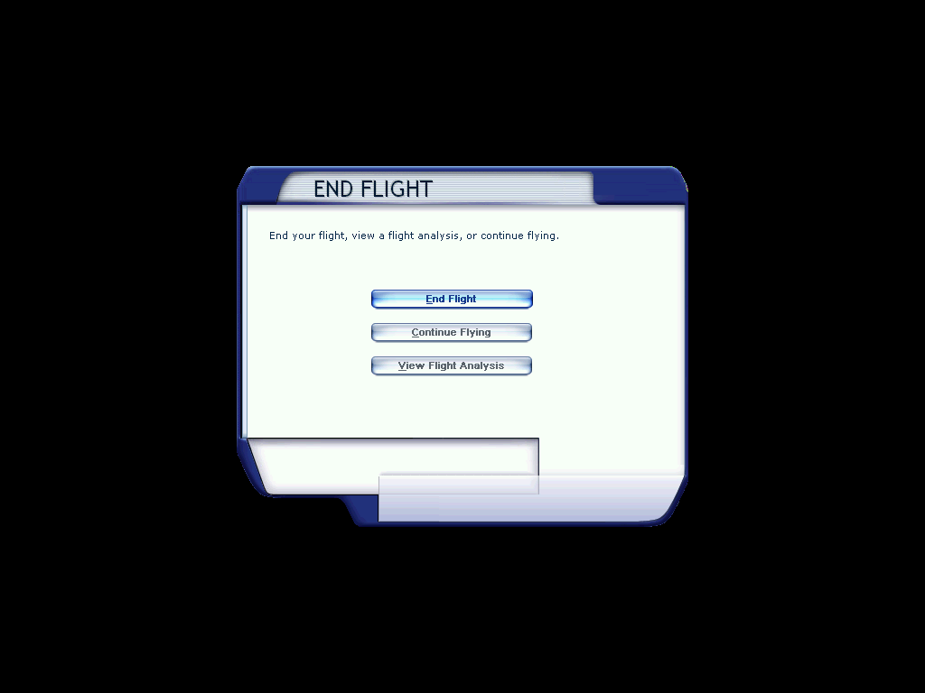

Hit esc to end you flight.

Slide 15
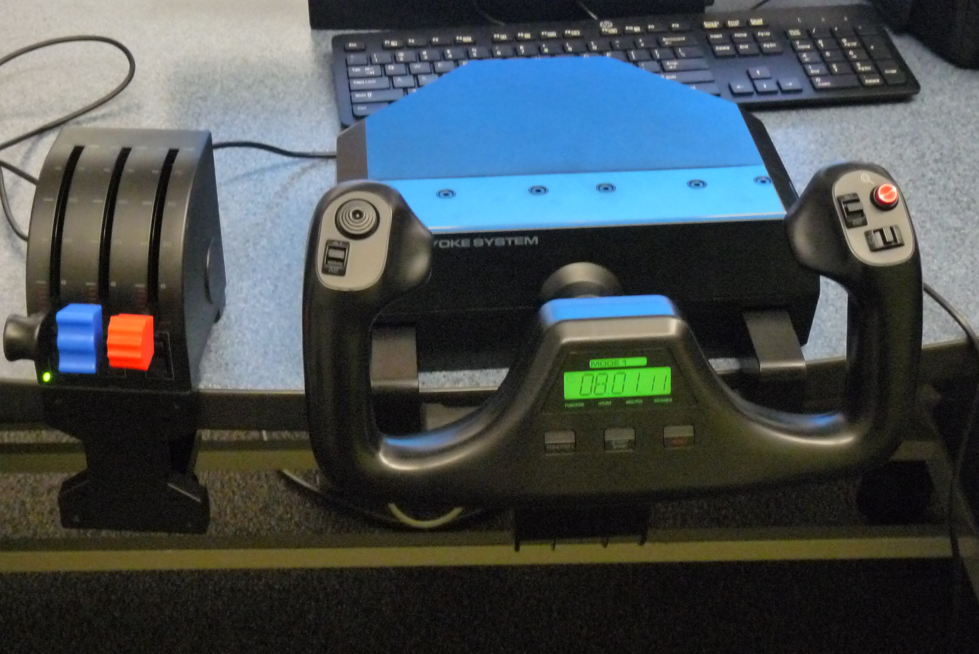
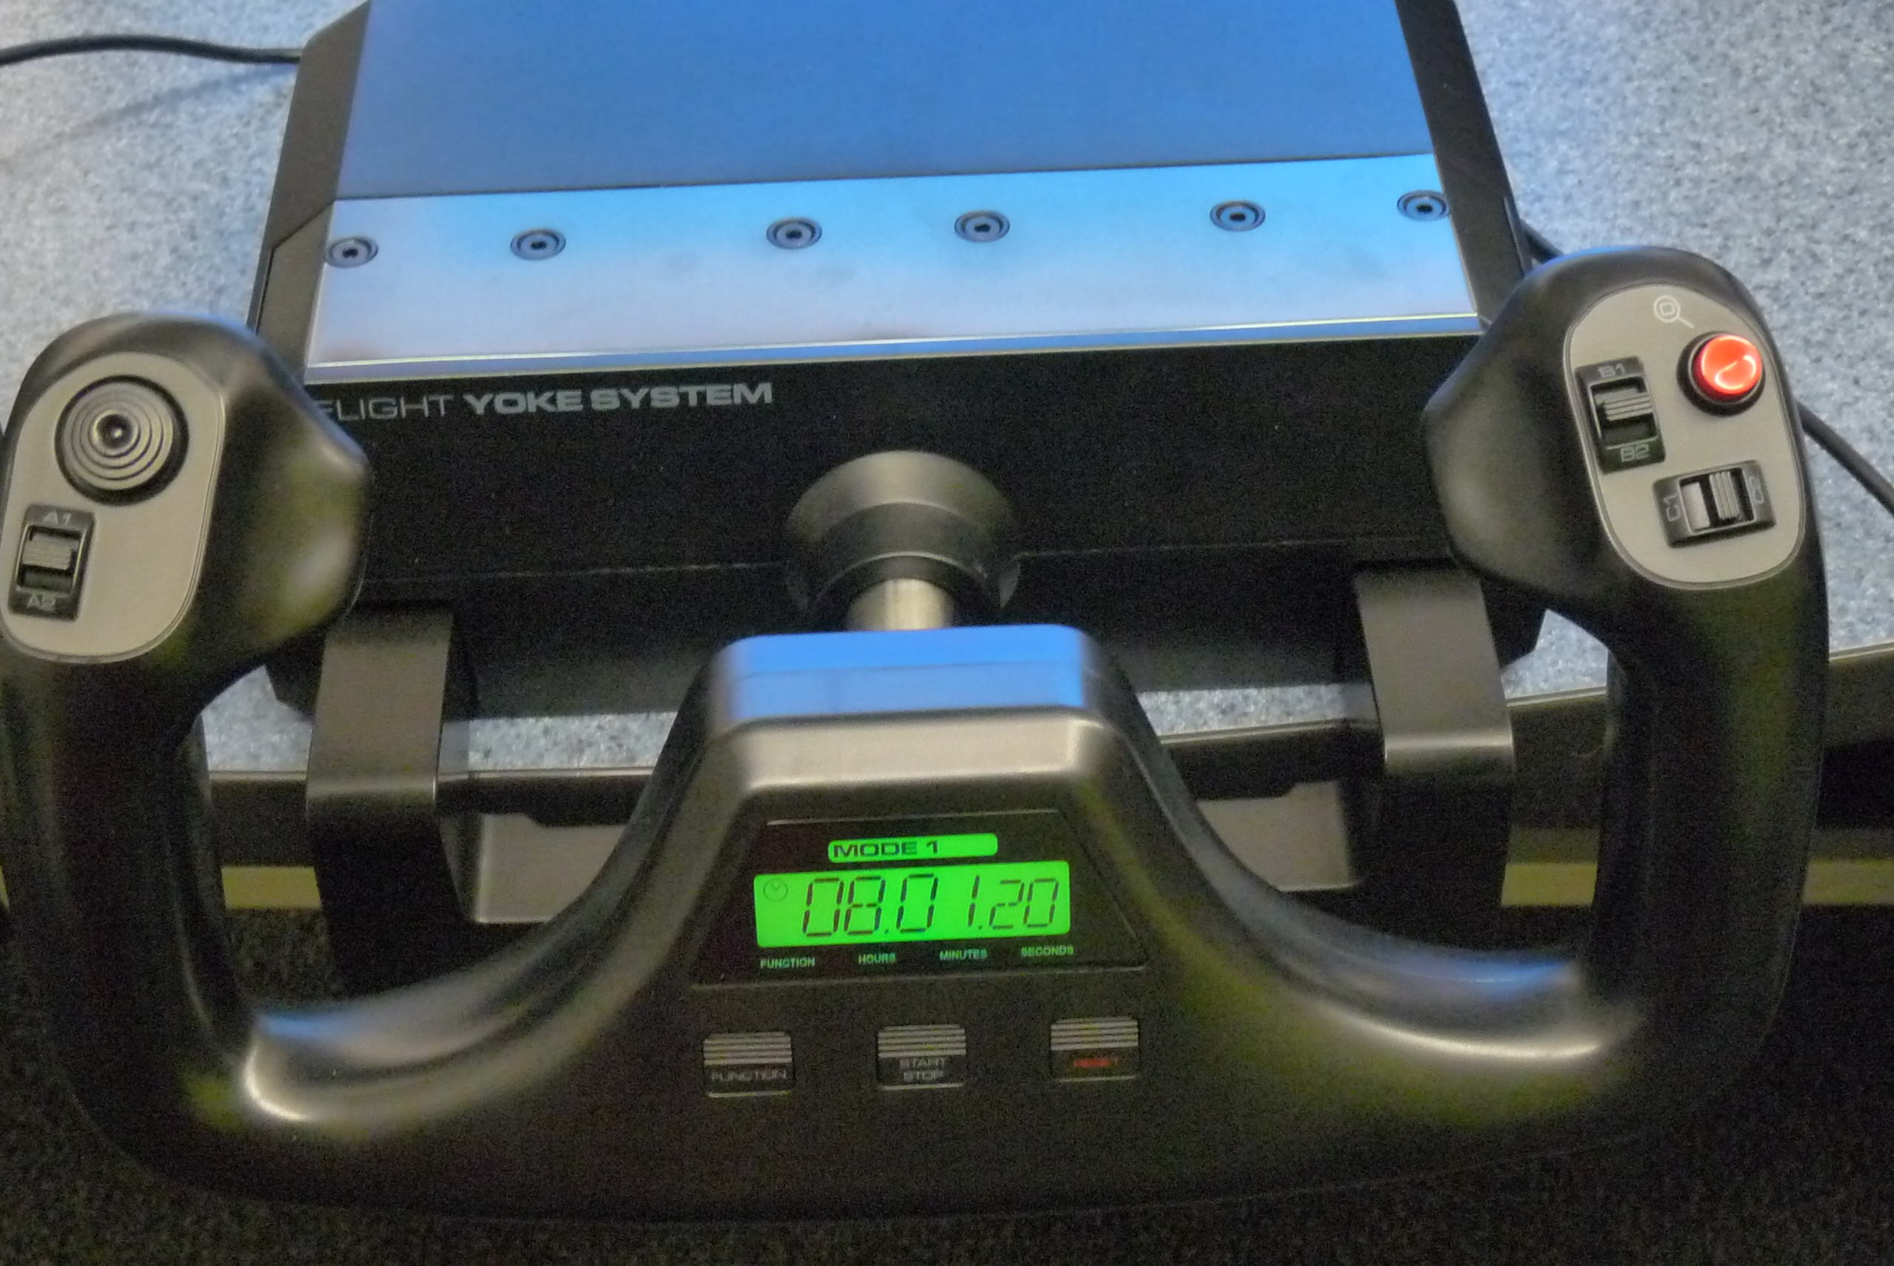
To change views
Controls
On some planes/helicopters is the flaps.
To move your view around.
Your system
On some planes/helicopters is the flaps.
To turn on/off you landing gear
This is your time(how long you have had it on) and/or stopwatch.

Slide 16
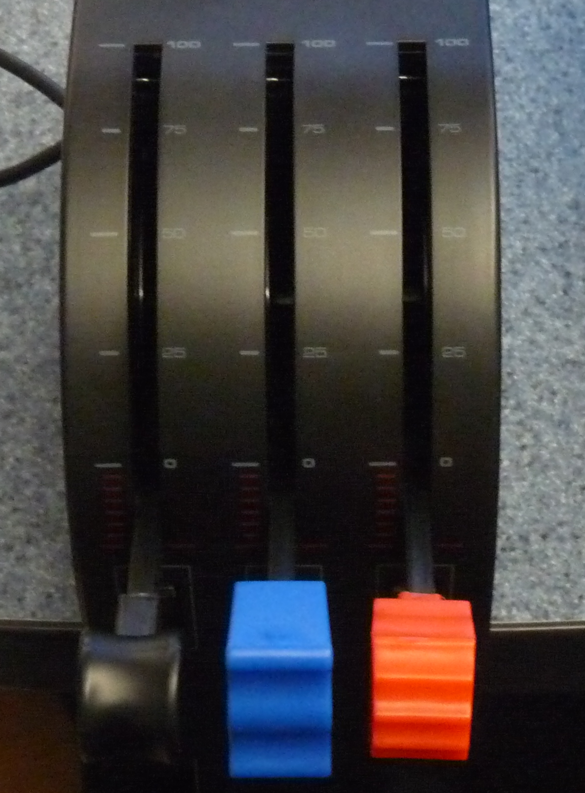
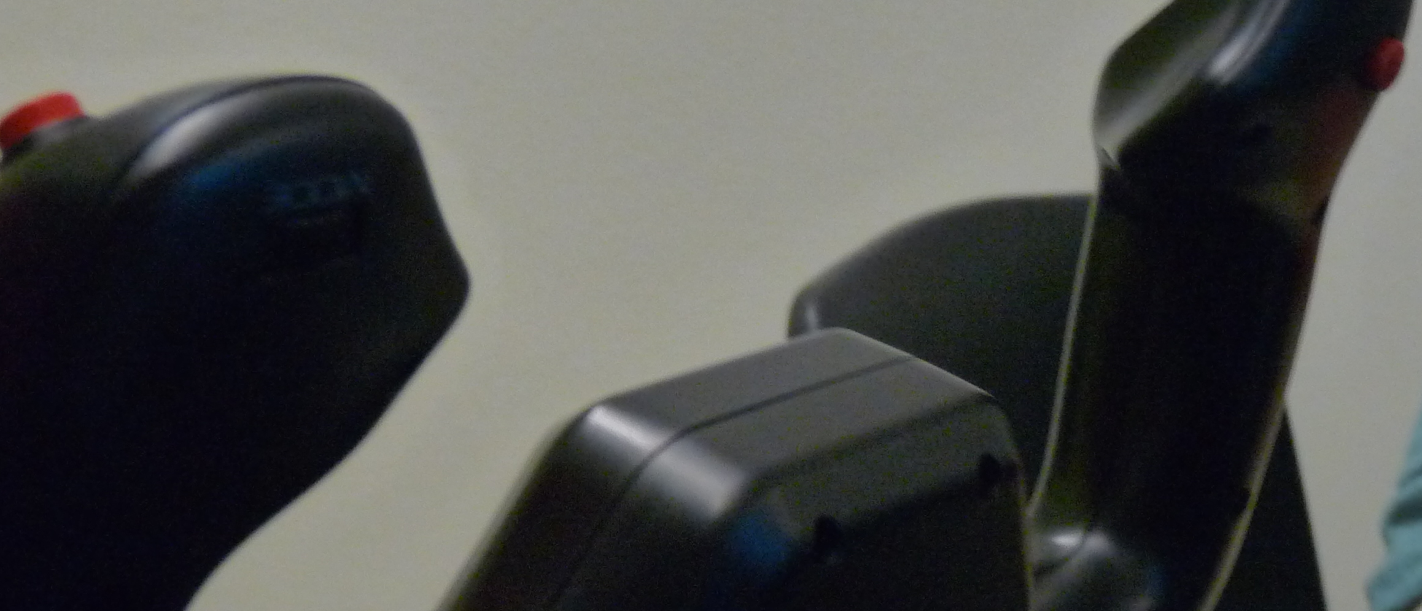
These we don’t know what they do.
This one controls your speed
These ones we don’t know what they do
We think they may be for different types of airplanes or helicopters, just for one type.

Slide 17
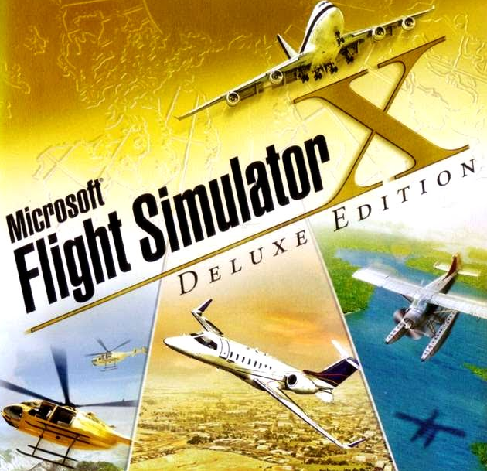
The End

